Slide 1
Tank Bot
By: Tasneem, Damian, Justin & Kristina

Slide 2
Introduction
this was our design for this years project. We have designed a Tank that we had named H.E.R.O.
This name stands for Heroic Engineering Robot Object.
In the beginning of the year, after much deliberation the team decided to make a Tank. From there we started to design, program, manage, and finalize the main concept of the vehicle.
The main objective of this project was to design a moving Vehicle. The objectives0. of this were; Can follow all requirement, by avoid all obstacles it encounters, move in straight lines, and run smoothly with little to no issues.
In the next, we will be talking about the requirements in more depth….

Slide 3
Project Requirements
The product requirements were to create a fast moving, durable vehicle that can avoid objects. Our Tank bot includes the following features:
Speed
Straight Line
90 degree Right turn
Durable
Turret Swivel
Reverse
Ultrasonic sensor
Recoil
Tank Hatch
Modular components
Shooting Sound
LED Light

Slide 4
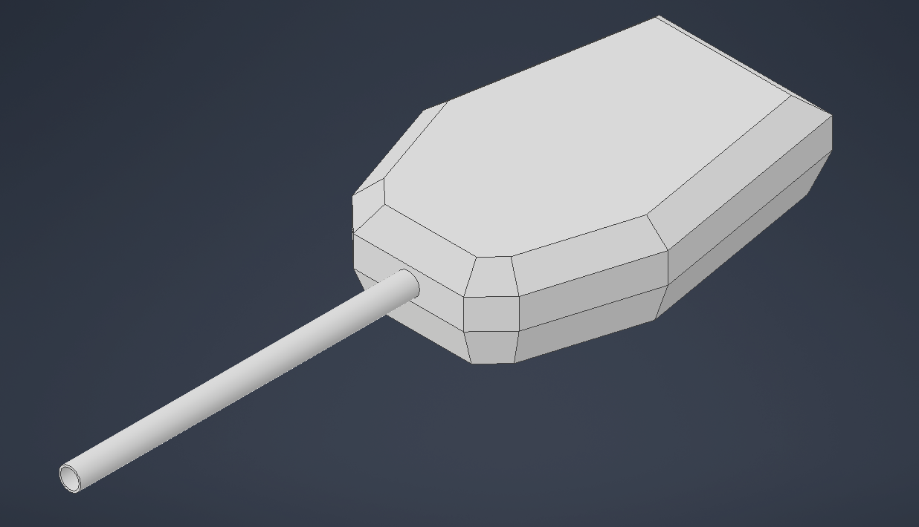
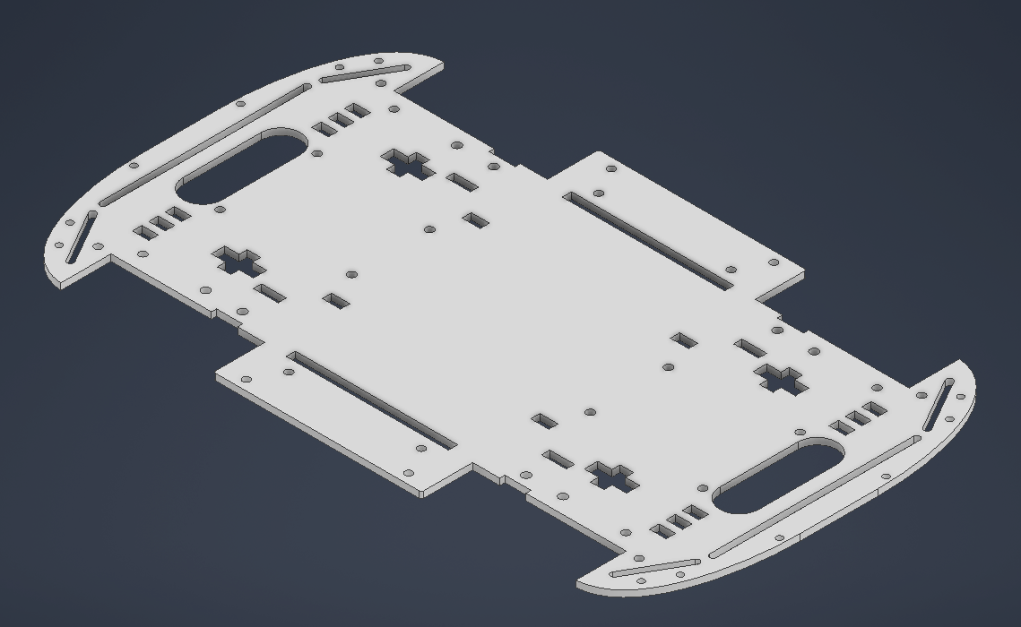
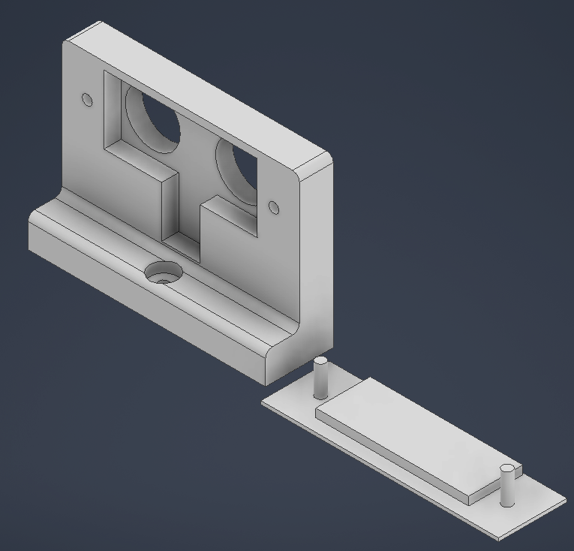
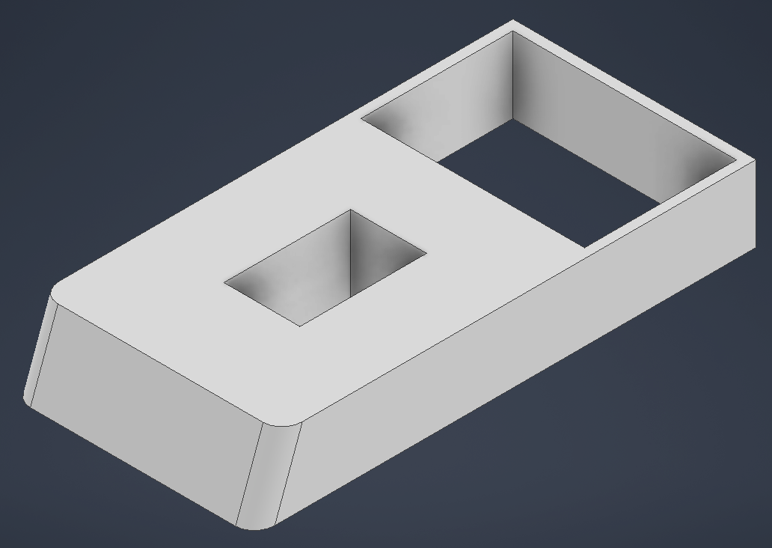
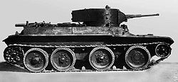
Design Approach
During the initial design approach we had 2 design plans
Ambulance truck
Tank
We finalized our choice with the tank, which led us to a design inspired by the BT Tank

Slide 5
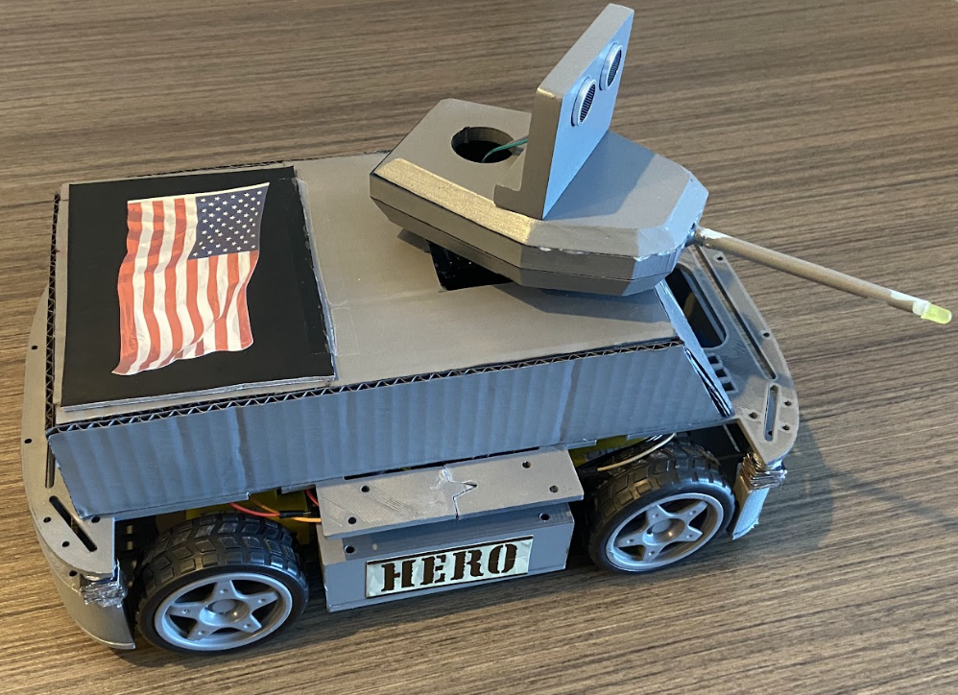
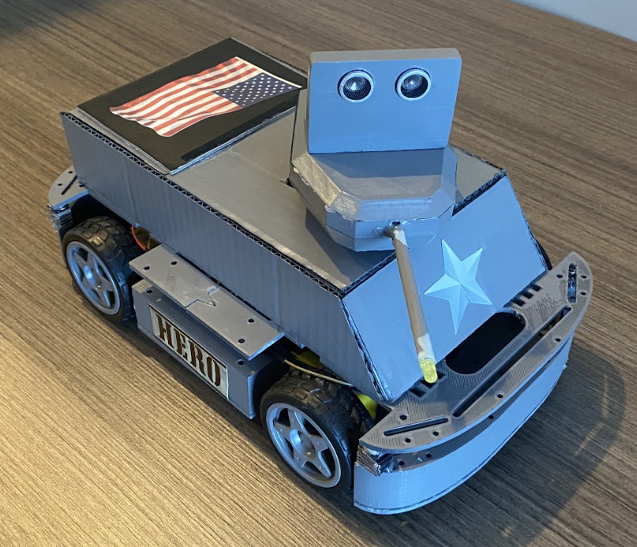
Final Design
As the last weeks approached we finalized our design leading us to
this
Some last minute features were also added during the assembly procedure
Magnetic top
Body spacers
Stickers

Slide 6
Test results
•Our tank ran at around 60% speed.
•Had to sacrifice speed to allow the servo to move around.
•Additional features include the following:
•recoil
•shooting sound
•muzzle flash
•color
•Turret swivel
•Our 3d printed frame gave the tank a sturdy foundation.
•Our tank was able to travel in a straight line with slight deviation

Slide 7
Conclusion
•Our group maintained good communication.
•Had assigned tasks each week
•Gave each other progress updates on our part of the project
•Let each other know the problems we encountered
•Our tank did not perform as we expected
•Causes
•Time
•Could not get the parts printed early
•Meant we could not test everything before the day of the test.
•resulted in unforeseen issues
•Main issue was that the wires prevented the servo from turning completely to the left
•Had to change the code last minute to compensate.

Slide 8
Conclusion
•Tank was too high
•We did not account for short boxes which resulted in collision.
•Things learned
•We needed to think about every situation.
•Reserve printers in advance to allow us to build earlier.
•Test more by building our tank earlier.

Slide 9
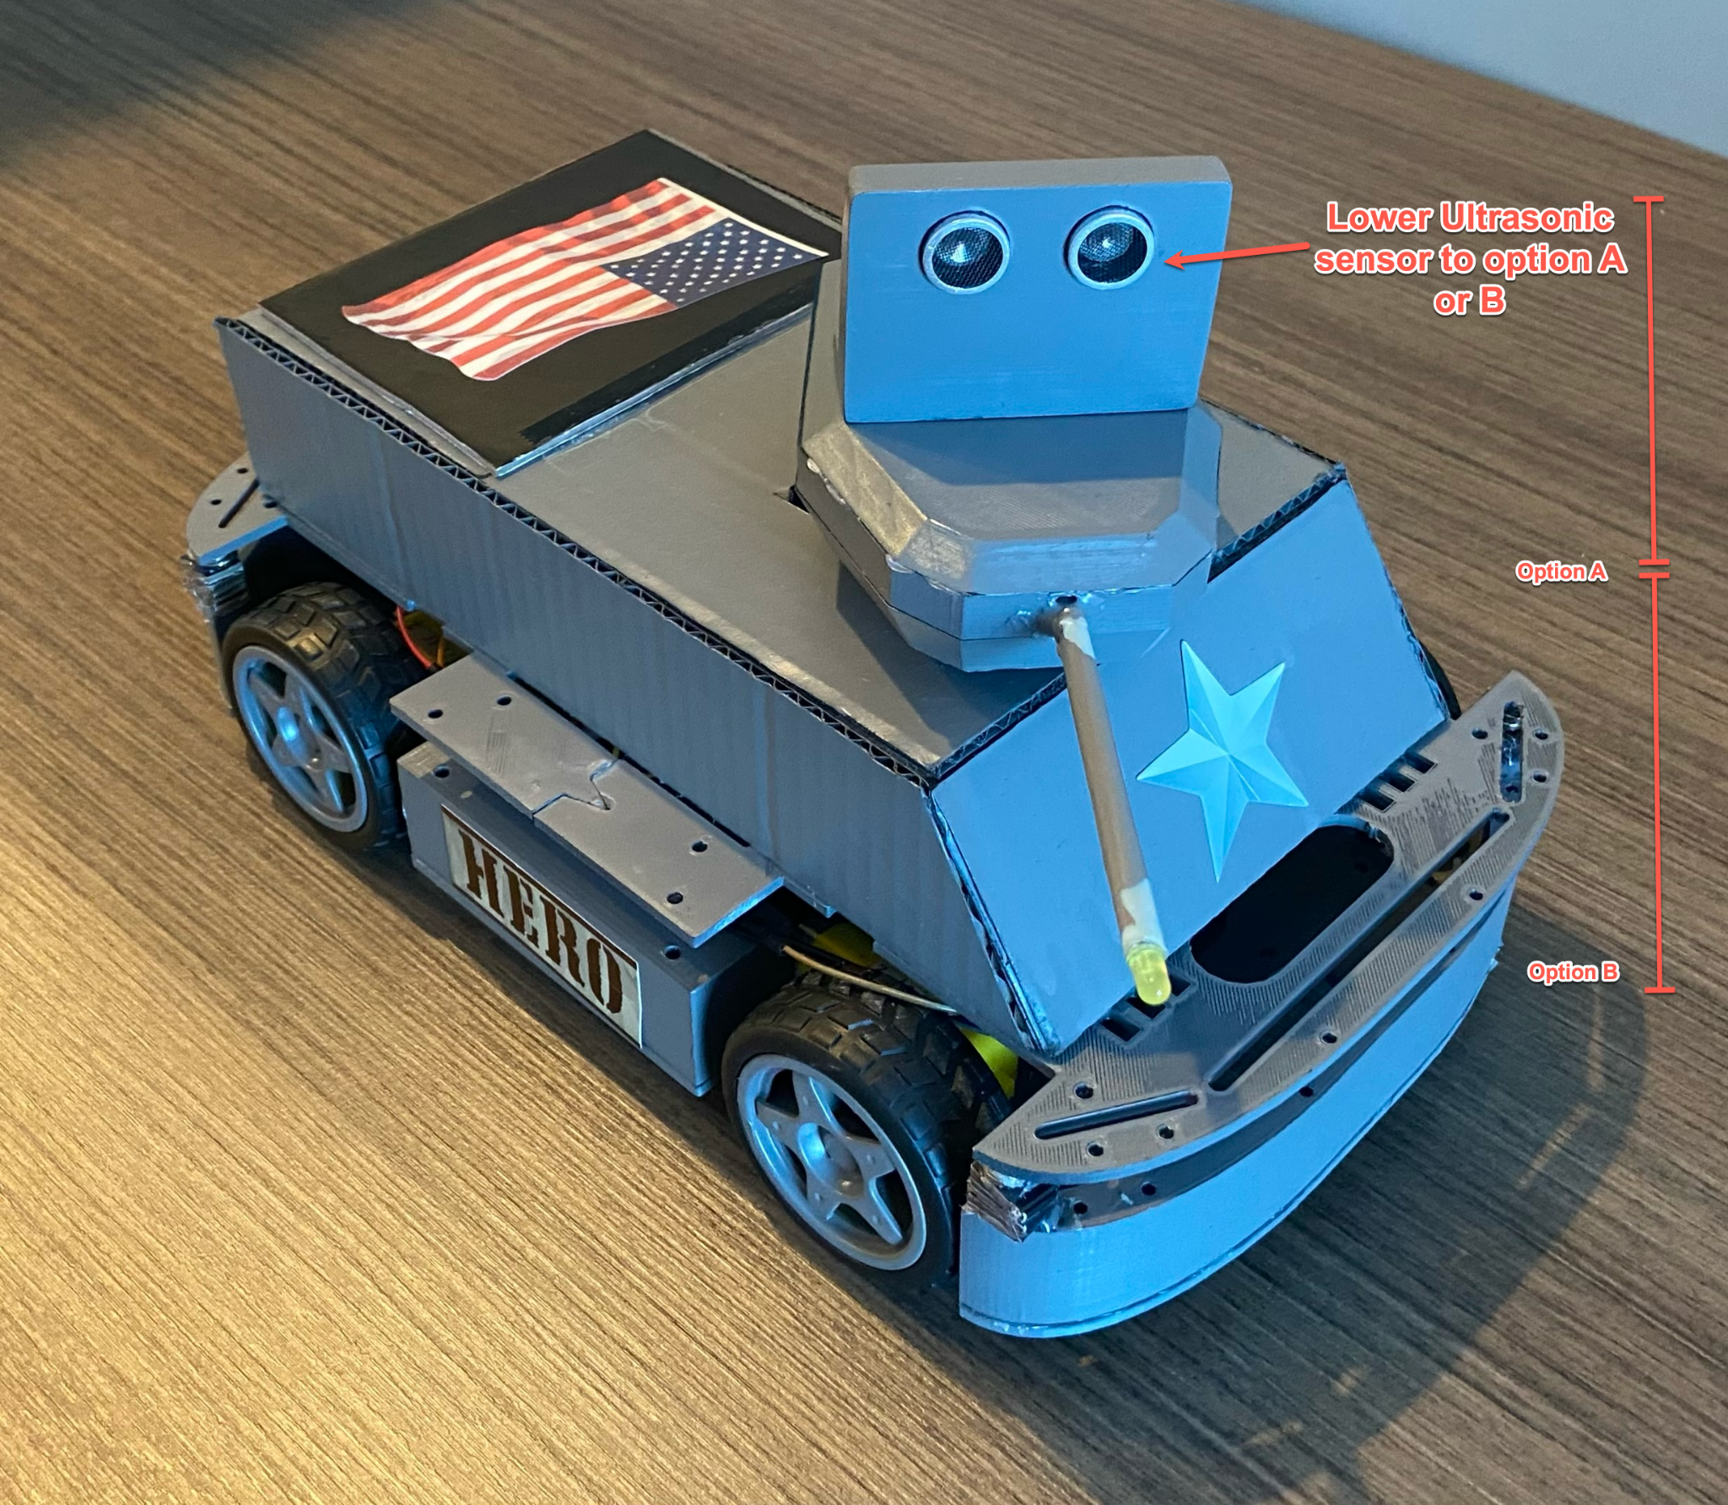
Recommendations for Future Development
Reduce Sensor Elevation
Include additional peripheral sensors
Create a timeline to implement backup plan sooner in case of timing issues especially if the project duration envelopes a holiday
Expect unexpected delays during Holidays
Consider complexity in relation to time frame available
Notes:
Lower the Sensor elevation to the middle or bottom chasis

Slide 10
Endnotes
In the end we completed H.E.R.O. the Tank
We learned a lot about the importance of communication with one another and sticking to a timeline for the project.
Finally we found that in the future we will allot more time toward assembly and completion testing with a focus on expecting the unexpected.

